Slide 1
XAI on Graphs
Hands-on Tutorial

Slide 2
Foliennummern
Groß und Kleinschreibung
Doppepunkte
Mein Name + Uni Paderborn auf Titelseite + Hintergrund zu GNNs
Auch in Fußzeile
Referenzen einheitlich ([Explainer], Autor, Jahr)
Einen GNN Ansatz evtl. In Detail besprechen
1 Folie zu Class Expressions als Explainers oder Evolearner
Mehr Abbildungen
Quellen für Folie 6: Arrieta + Schwalbe
Abducitve reasoning nach Wiki
Graphic zu Folie 16
Motif vorher erklären
Zu HoT: Einführungsfolien + Beispiele
Accuracy: Erkläre fehlende TN
Fidelity: Erkläre Variablen (auch n = #) + gebe kleines Beispiel
Accuracy auf letzter Folie anders
Folie 8 visualisieren
Accuracy: Genauer sagen, wie TP etc. Berechnet wird
Gleiches schwarz auf allen Folien !!

Slide 3
Introduction
This slides aim to explain Explainers of GNNs, which are implemented by GraphXAI (Agarwal, Chirag et al., 2023)
Additionally, everybody is encouraged to work with this implementation on synthetic datasets during the hand-on tutorials (hot)

Slide 4
Overview
Definition of XAI
What is an Explanation?
Taxonomy of Interpretability
HoT 1
Optimizing Explanations
Evaluation Methods
Conclusion & Outlook
HoT 2

Slide 5
Definitions of XAI
Interpretability is the degree to which a human can understand the cause of a decision. (Miller, 2019)
Interpretability is the degree to which a human can consistently predict the models result. (Kim et al., 2016)
The model itself becomes the source of knowledge instead of the data. Interpretability makes it possible to extract this additional knowledge captured by the model. (Molnar, 2020)

Slide 6
Goals of XAI
DARPA: XAI program aims to create a suite of ML techniques, that:
Produce more explainable models while maintaining a high level of prediction accuracy
Enable human users to understand, appropriately trust, and effectively manage the emerging generation of AI partners

Slide 7
Who wants to achieve what in XAI?
Data Scientists want to Improve Did the model use all relevant input? Feature engineering Detect flaws: Has the model only learned in the expected way? | Decision Makers want to Justify & Control Develop trust Assess regulatory compliance Use models appropriately
Governments want Fairness & Predictability DSGVO/GDPR: Citizens have a right to an explanation, e.g. healthcare, police searches Detect discriminatory patterns | Domain Experts want to Discover Has the model detected a connection that was previously missed out?
Following: (Arrieta, 2020) and (Vilone, 2020)

Slide 8
What is an Explanation?
Explaining Functions in general
Psychology of Explanations
Why Explanations are Important

Slide 9
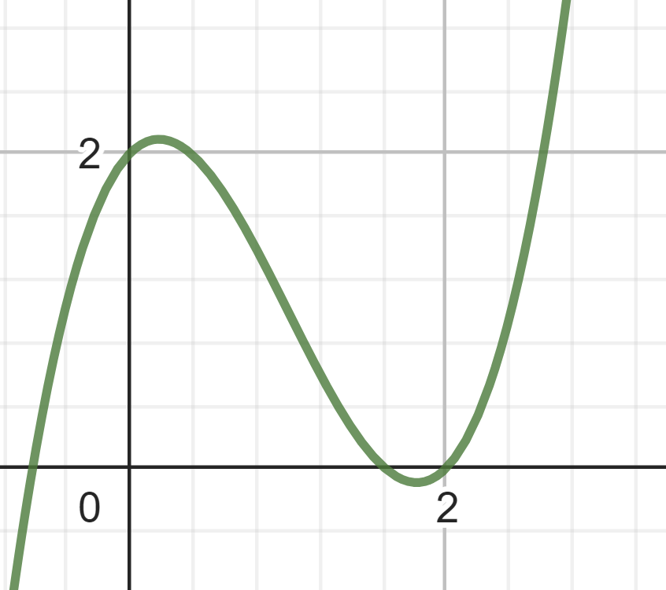
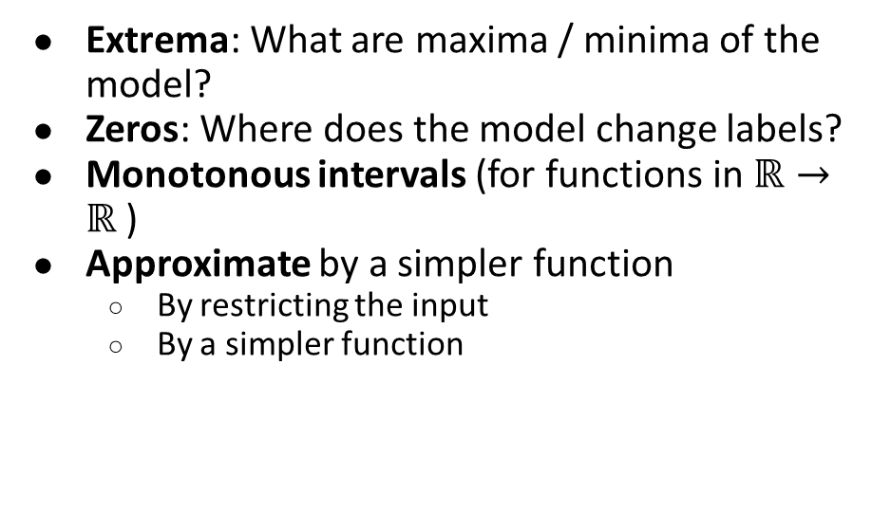
Explaining functions: Discussion of curves (binary classification)
Extrema: What are maxima / minima of the model?
Zeros: Where does the model change labels?
Monotonous intervals (for functions in $ℝ→ℝ$)
Approximate by a simpler function
By restricting the input
By a simpler function

Slide 10
Psychology of Explanations
People often tend to abductive reasoning
Seeking the simplest & most likely explanation: ”Given our theories T of the world: If A where true, the observation O would be a matter of course”
Explanations are incomplete and could be falsified empirically
Selecting explanations for correct abductive reasoning is crucial
Statistics don’t matter
People cannot think well about statistics (Kahneman, 2011)
People take the most probable explanation always as the best explanation
Explanations should be contrastive:
Why was P predicted and not Q?
Social explanations:
Only say, what is truly believed, what is necessary and what is relevant
Already known information is unnecessary
Following: Miller (2019); and Hoffmann et al. (2023)

Slide 11
How explanations help understanding
Prediction by AI
Explanation by XAI
Users initial mental model
Users revised mental model
Inapproriate Trust
Appropriate Trust
Inapproriate Use
Appropriate Use
Worse Performance
Better Performance
Graphic Idea from Figure 1 in (Hoffmann et al. 2023)

Slide 12
Problems by explaining AI to end-users
How do we know, if the user has achieved a pragmatic understanding of the AI? (Hoffman et al., 2018)
What is the mental model of end-users of XAI? Is it in line with how XAI works? (Langer et. Al, 2021)
Do users learn to to appropriately use the model, or do they blindly follow / neglect the model? (Poursabzi-Sangdeh, et al., 2021)

Slide 13
Taxonomy of interpretability: Explanator as a function
Input
Output
Set of pausible explanations & method finding it
Following (Schwalbe et al., 2023) and (Molnar, 2022)

Slide 14
Input of explainer
Post-hoc vs. Intrinsic
the model output or the models’ input as input
Locality: Global vs. Instance explanation
whole predictions or just one prediction as input
Portability: Model-specific vs. Model-agnostic
The model as input, or just the model output
Taken from Molnar; and from Schwalbe et al.

Slide 15
Output of explainer
Explanatory subgraph
As important input for an instance explanation
As a global explanation or prototype explanations
As counterfactuals
Surrogate Model
Logical Rules / Explanations

Slide 16
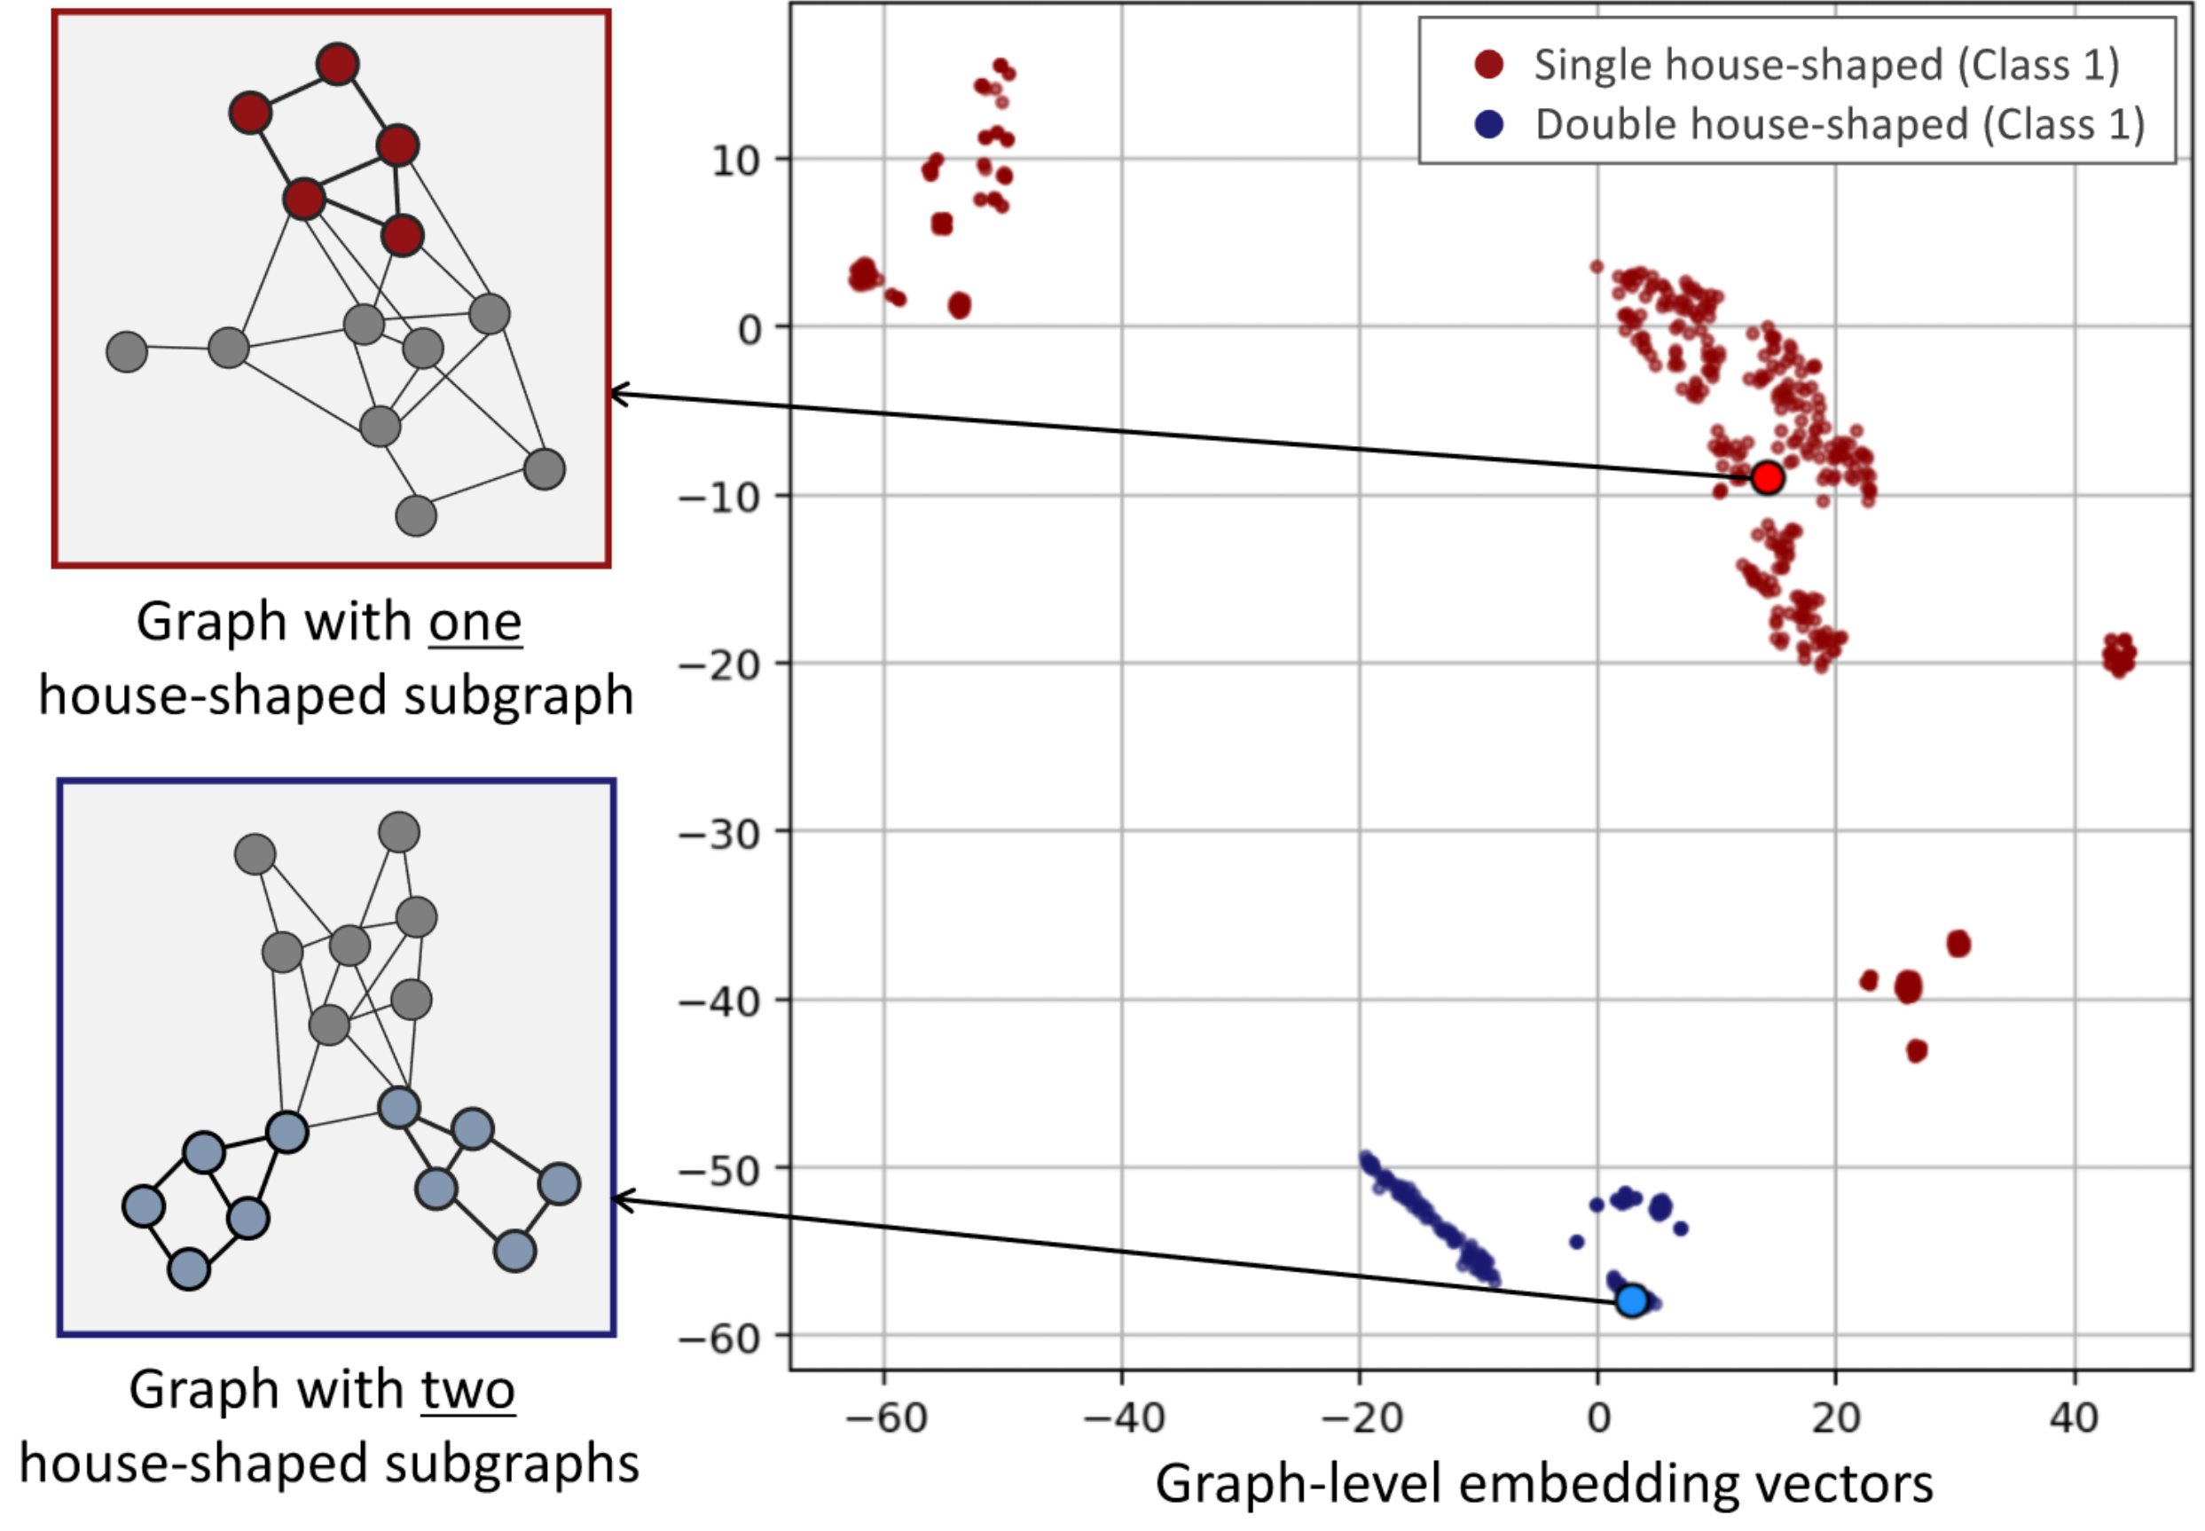
Prototype explanations
Example: a GNN to classify:
Graphs with 1 house motif
Graphs with 2 house motifs
Graphik from Fig. 3 in (Yong-Min Shin, et al., 2022)

Slide 17
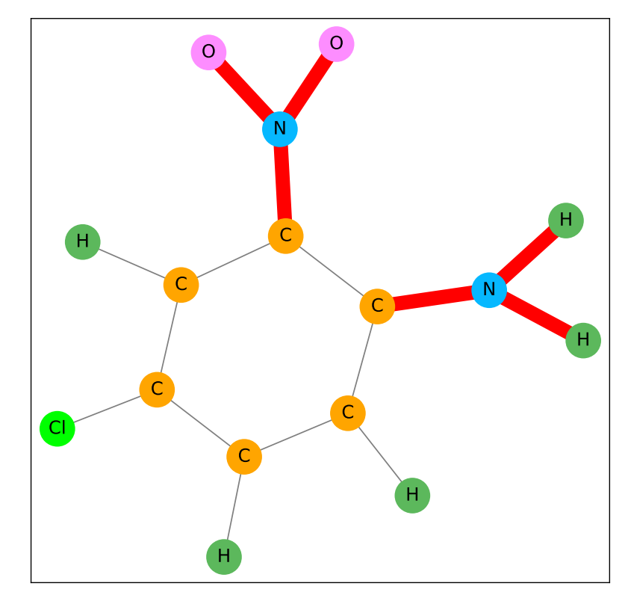
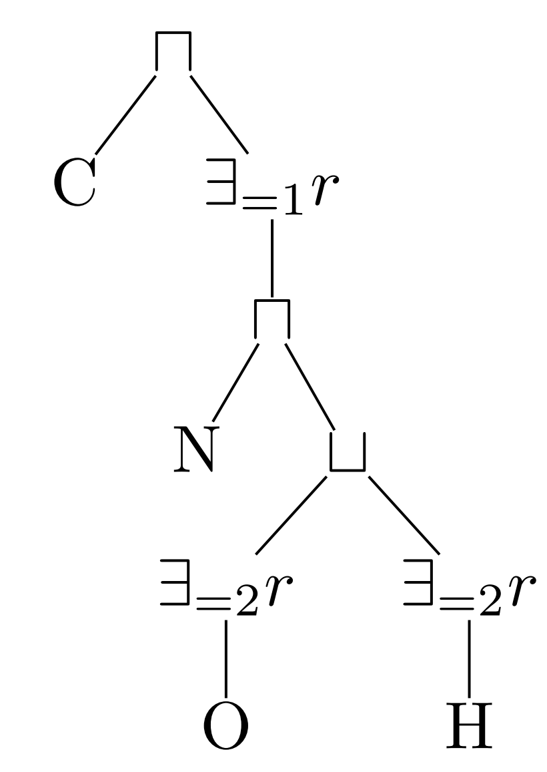
Logical expressions for MUTAG
Can distinguish between different possible explanations
Graphik from Fig. 5 Tien-Cuong Bui, et al. (2022)
Mutag Dataset used e.g. in PGExplainer (Dongsheng Luo, et al., 2020) and GNNExplainer (Zhitao Ying, et al., 2019)

Slide 18
Finding the best Explanation
Optimization Framework:
Mutual Information
GNN-Output
Backpropagation / Feature Importance
Regularization: Length of Explanation, connected Subgraph, ...

Slide 19
Explanations of GNNs
Finding an important subgraph, which explains a label
Instance explanations: Masking important input
Node Masks
Edge Masks
Feature Masks
Global explanations: One explanatory graph for a label
Select a prototype instance explanation
Create synthetic graphs

Slide 20
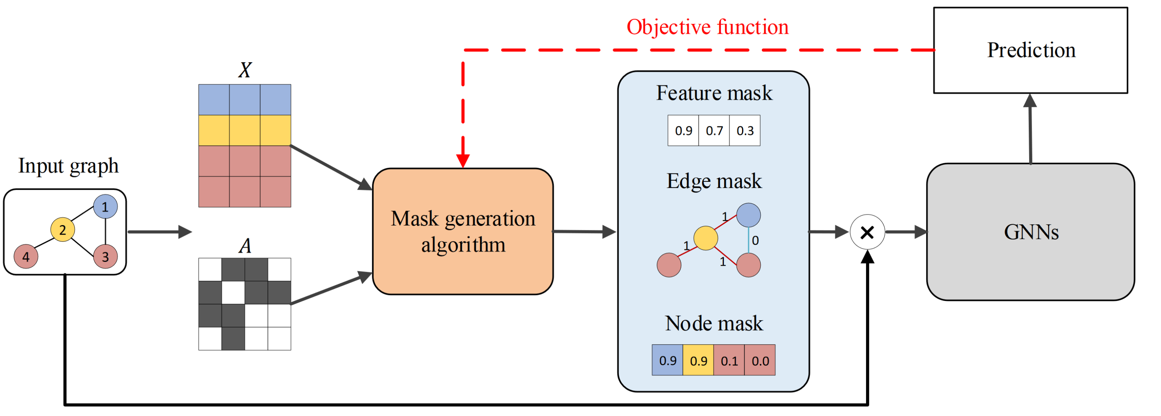
Statistics on input data
Picture from Fig. 2 in (Hao Yuan, et al., 2023)

Slide 21
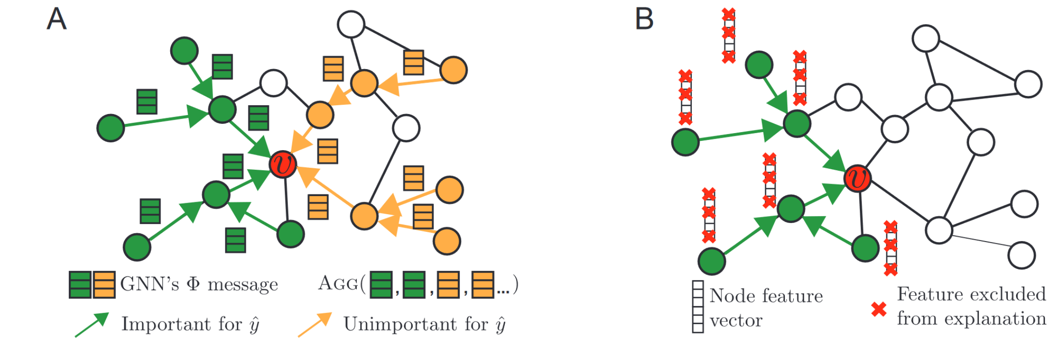
Node masks: GNNExplainer
Picture from Figure 2 in GNNExplainer: (Zhitao Ying, et al., 2019)

Slide 22
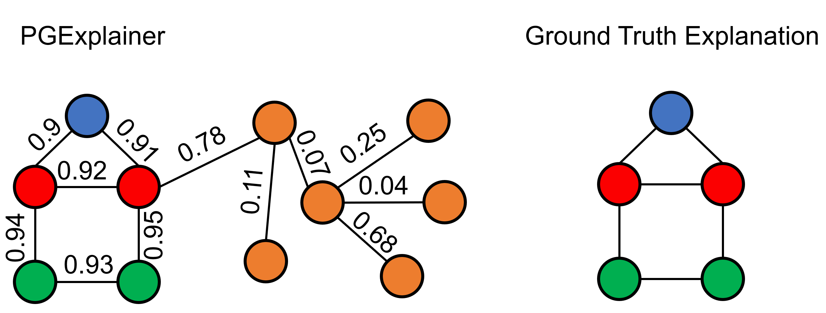
Edge masks: PGExplainer
PGExplainer: (Dongsheng Luo, et al., 2020)

Slide 23
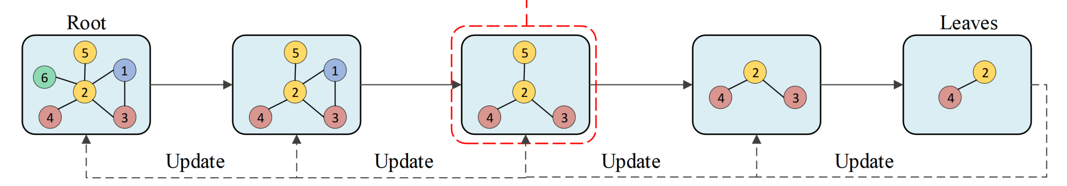
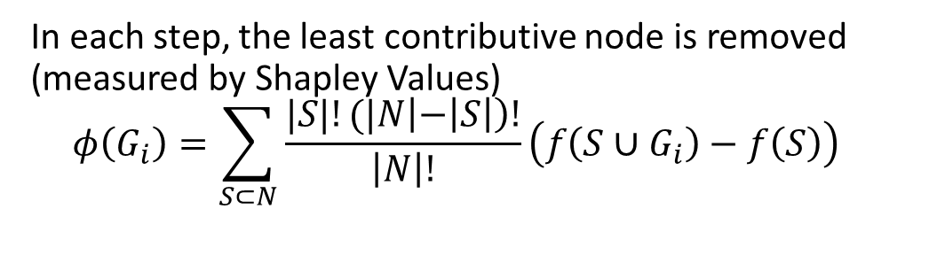
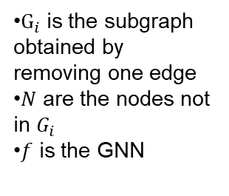
Obtaining a subgraph by removing edges: SubgraphX
In each step, the least contributive node is removed (measured by Shapley Values)
$$φ\left(G_{i}\right)=\sum_{S⊂N}{\frac{|S|!(|N\left|−\left|S\right|\right)!}{\left|N\right|!}\left(f\left(S∪G_{i}\right)−f\left(S\right)\right)}$$
$G_{i}$ is the subgraph obtained by removing one edge
$N$ are the nodes not in $G_{i}$
$f$ is the GNN
Graphic from: Yuan, Hao, et al. (2021)

Slide 24
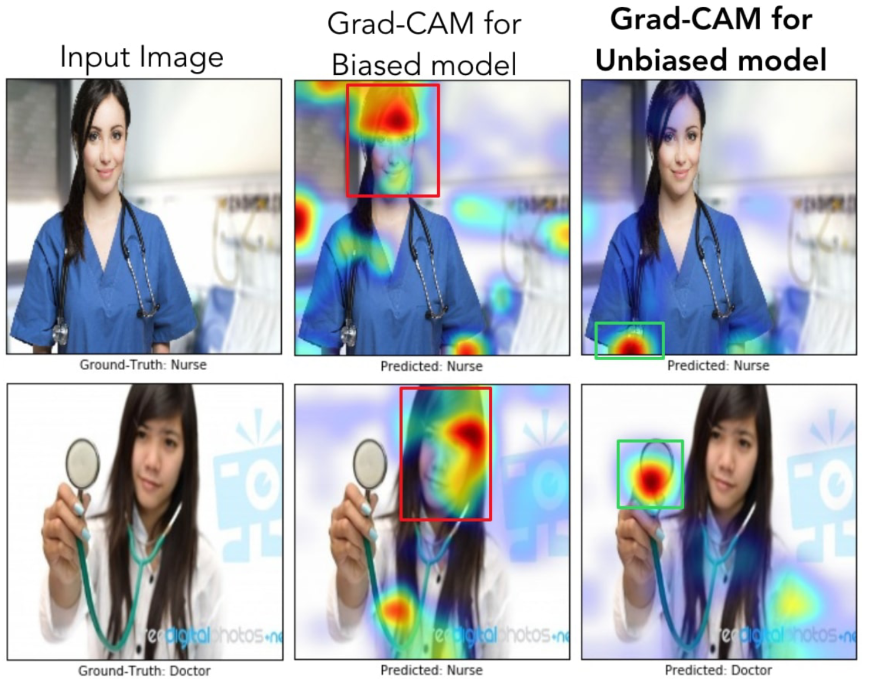
Obtaining a subgraph by gradients
Algorithms: Grad-Cam, Cam, Gradient, Guided Backpropagation
Adopted from CNNs, not specifically tailored to GNNS
Aggregate gradients from last CNN layers, to find relevant input pixels
Graphic from Fig. 8 in (Ramprasaath R. Selvaraju, et al., 2020)

Slide 25
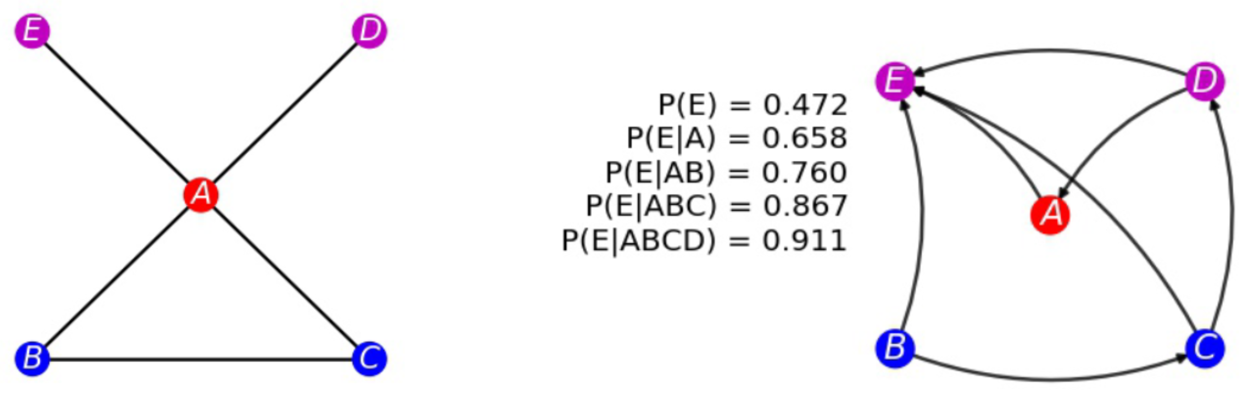
Probabilistic graph model (PGM)
Surrogate model for node classification
Trains a bayesian network to capture statistical dependencies, observed by perturbated input
Motif
Bayesian network for dependencies
Graphik from Fig. 1 in (Minh N. Vu, et al., 2020)

Slide 26
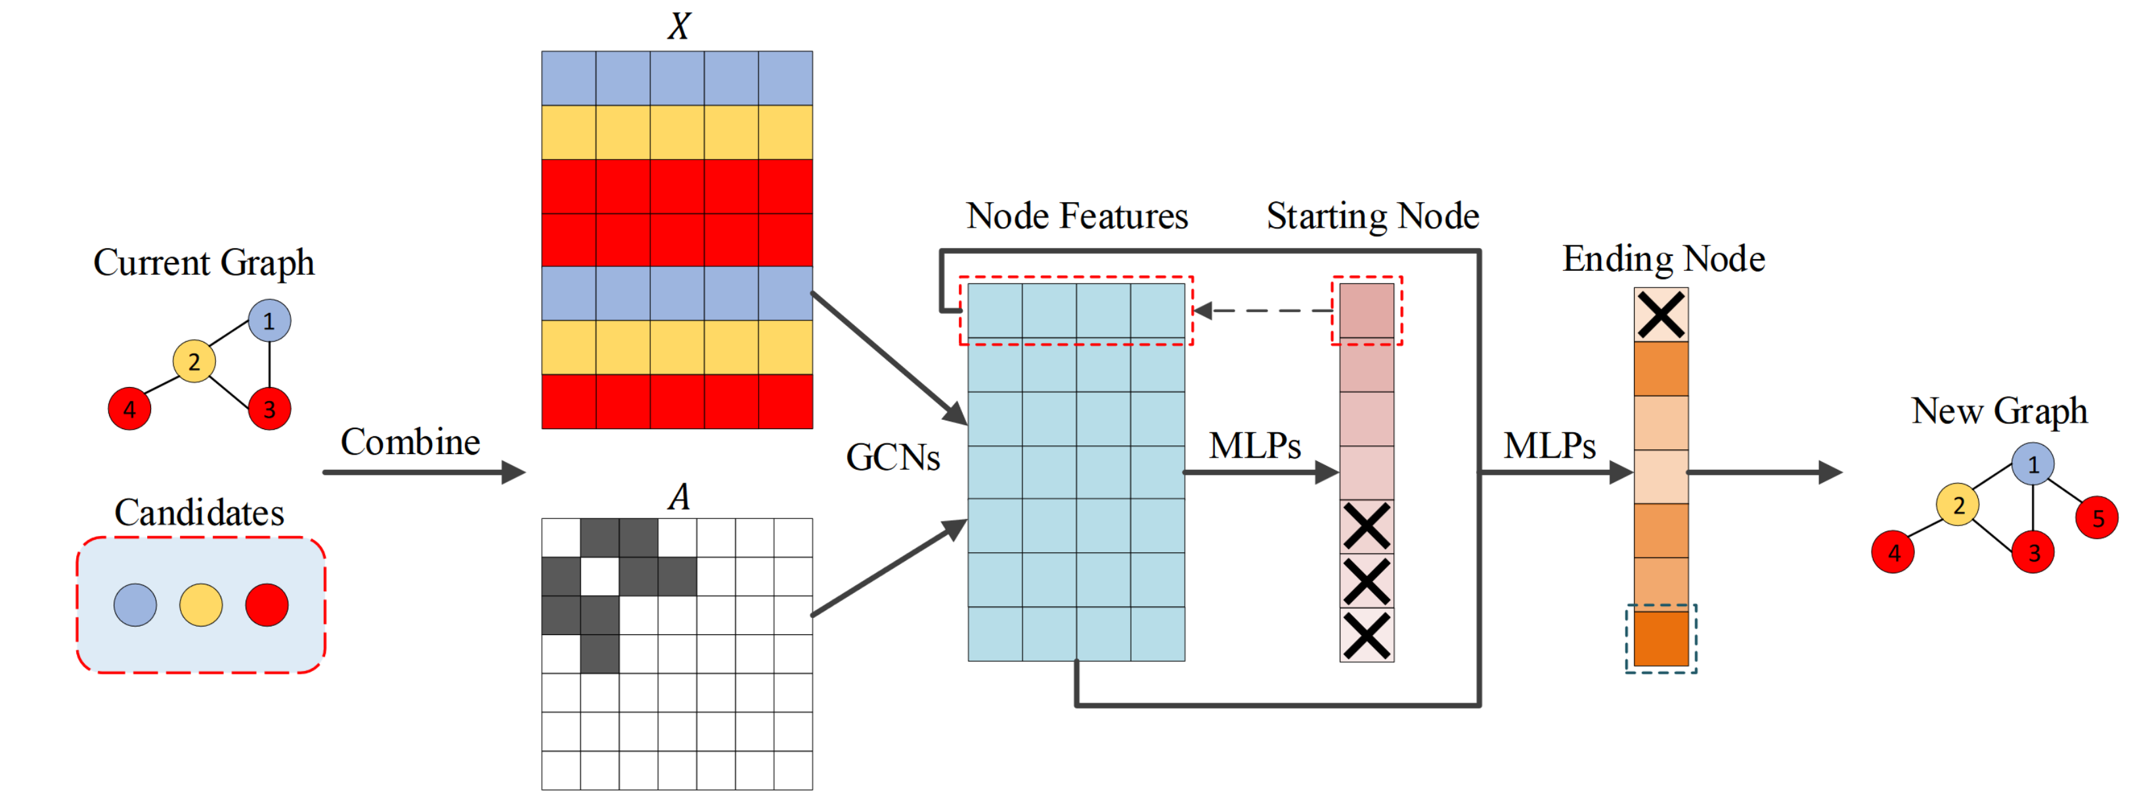
Generating an explanation
RGExplainer: Building the explanatory subgraph
Reinforcement Learning
XGNN, GNNInterpreter: Creating a new subgraph
Reinforcement Learning; One-shot Graph Generation
Graphik: Fig. 2 in (Hao Yuan, et al., 2020)

Slide 27
Further Interaction
Hands on – Looking at explanations of Motif Datasets
Optimizing Explanations
Intrinsic Models: Ideas how they could work
Evaluating explanation methods
Another Hands-on Session

Slide 28
Hands-on Tuturial on Evaluating Explanations
Dataset: Different Motifs; GNN learns to identify nodes in the motif
Several Explainers, which try to identify the ground-truth motif
Further Instructions ???

Slide 29

QR CODE for HOT
Link: https://github.com/mathematiger/Hands_on_GraphXAI

Slide 30
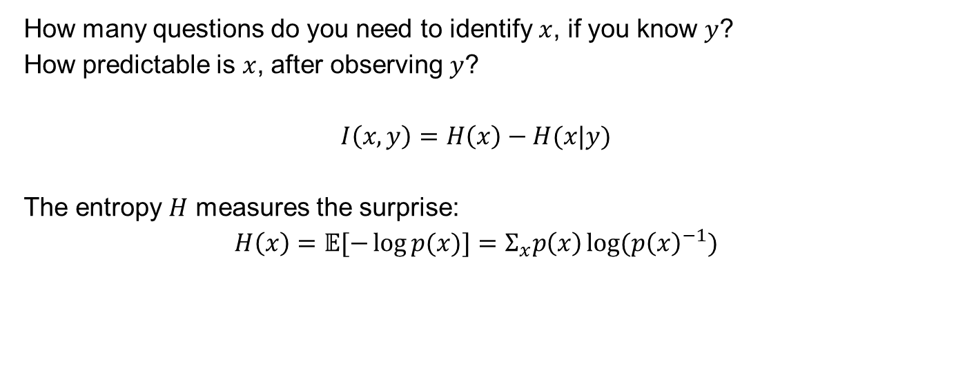
Optimization: Mutual Information
How many questions do you need to identify $x$, if you know $y$?
How predictable is $x$, after observing $y$?
$$I\left(x,y\right)=H\left(x\right)−H(x|y)$$
The entropy $H$ measures the surprise:
$$H\left(x\right)=𝔼[−\log{p(x)}]=Σ_{x}p\left(x\right)\log{(p{\left(x\right)}^{−1})}$$
How often it is used
Number of y/n Questions needed ( = #bits)

Slide 31
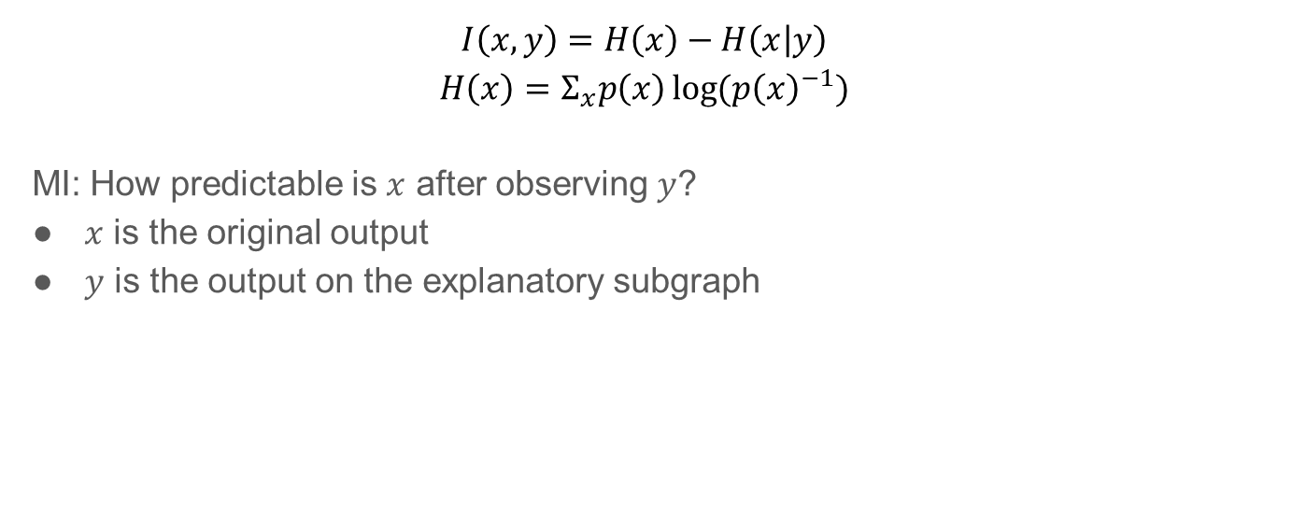
MI in XAI
$$I\left(x,y\right)=H\left(x\right)−H\left(x | y\right)$$
$$H\left(x\right)=Σ_{x}p\left(x\right)\log{(p{\left(x\right)}^{−1})}$$
MI: How predictable is $x$ after observing $y$?
$x$ is the original output
$y$ is the output on the explanatory subgraph

Slide 32
Difference of MI and GNN-output
MI:
Finds input, which very clearly explains one label (not necessary the to-be-explained label)
Assumption: Masking the input only purifies the label, instead of changing the prediction
GNN-output:
Finds input, which is most relevant for the to-be-explained label, but possible also for other labels

Slide 33
Regularization
Lenght of explanation
Number of Nodes
Upper sum on probabilities of selected nodes
Maximal distance of 2 nodes
Connected subgraphs
Directly from optimization framework
Higher likelihood for adjacent edges of selected explanatory output
Similarity
Similarity of node representations
Explanation graph being ”realistic” compared to the input data, e.g. molecule data
(Caihua Shan, et al., 2021), (Dongsheng Luo, et al., 2020), (Xiaoqi Wang, et al., 2023)

Slide 34
Evaluation of XAI on graphs
Functionally Grounded: Accuracy, Faithfulness, fidelity, ...
Human Grounded: Degree of understanding
Application Grounded: Performance increase
Taxonomy following (Finale Doshi-Velez, et al., 2017)

Slide 35
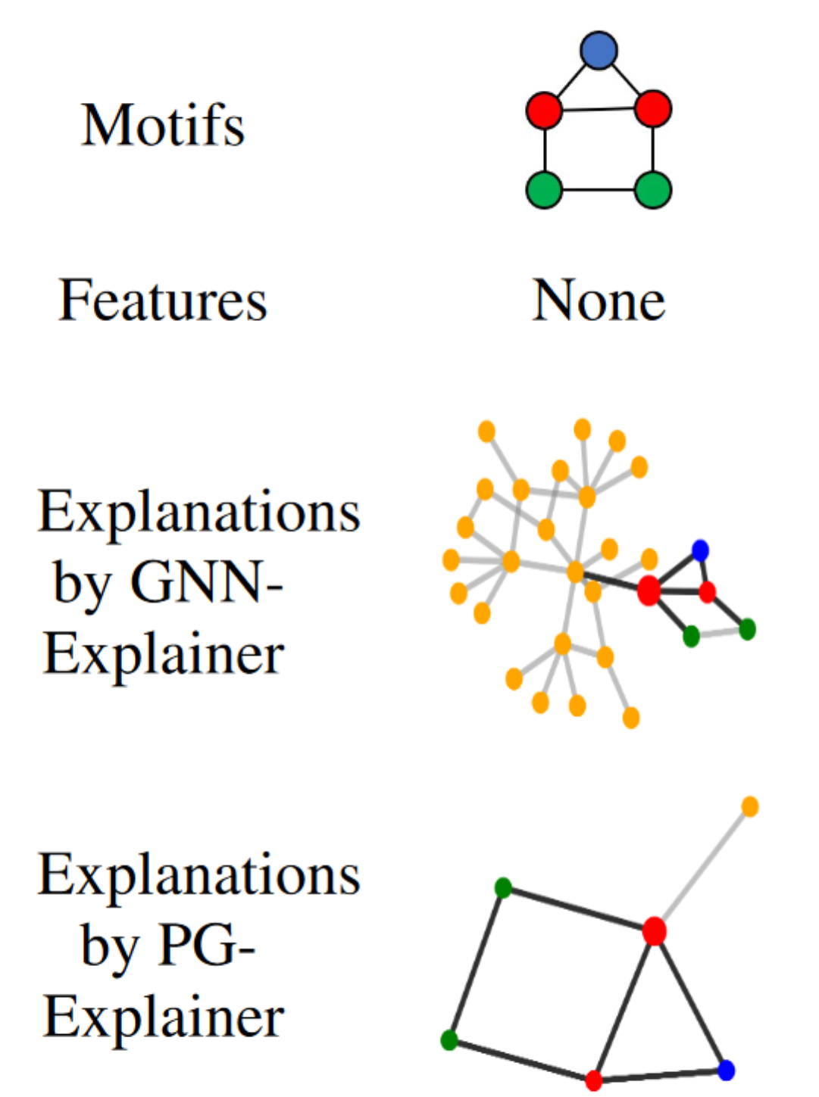

Accuracy to Ground-Truth
$$acc=\frac{TP}{TP+FP+FN}$$
Following: Agarwal et al. (2023)
Graphic from Table. (Dongsheng Luo, et al., 2020)

Slide 36
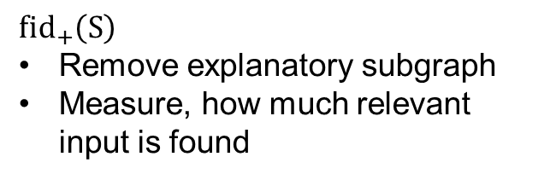
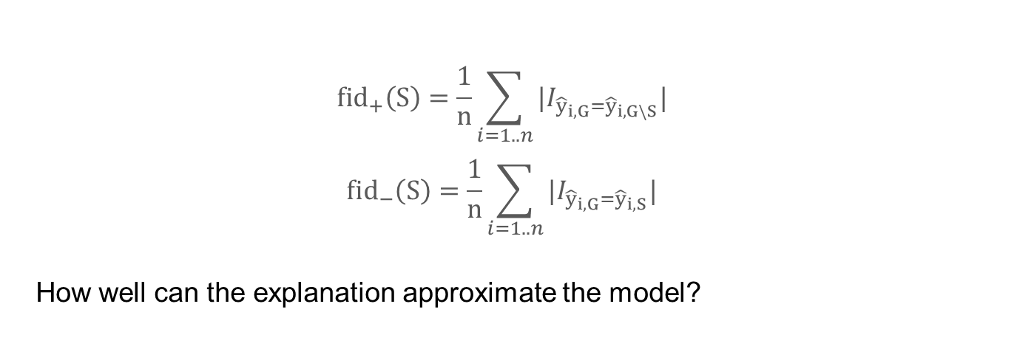
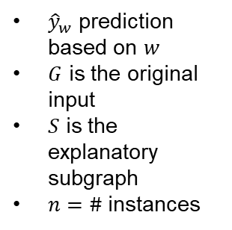
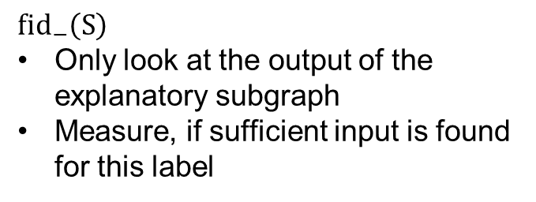
Fidelity
${\hat{y}}_{w}$ prediction based on $w$
$G$ is the original input
$S$ is the explanatory subgraph
$n=\#$instances
$$fid_{+}\left(S\right)=\frac{1}{n}\sum_{i=1..n}{|I_{{\hat{y}}_{i,G}={\hat{y}}_{i,G\backslash S}}| }$$
$$fid_{−}\left(S\right)=\frac{1}{n}\sum_{i=1..n}{|I_{{\hat{y}}_{i,G}={\hat{y}}_{i,S}}| }$$
How well can the explanation approximate the model?
$$fid_{+}\left(S\right)$$
Remove explanatory subgraph
Measure, how much relevant input is found
$$fid_{−}\left(S\right)$$
Only look at the output of the explanatory subgraph
Measure, if sufficient input is found for this label
Follwing (Kenza Amara, et al., 2022)

Slide 37
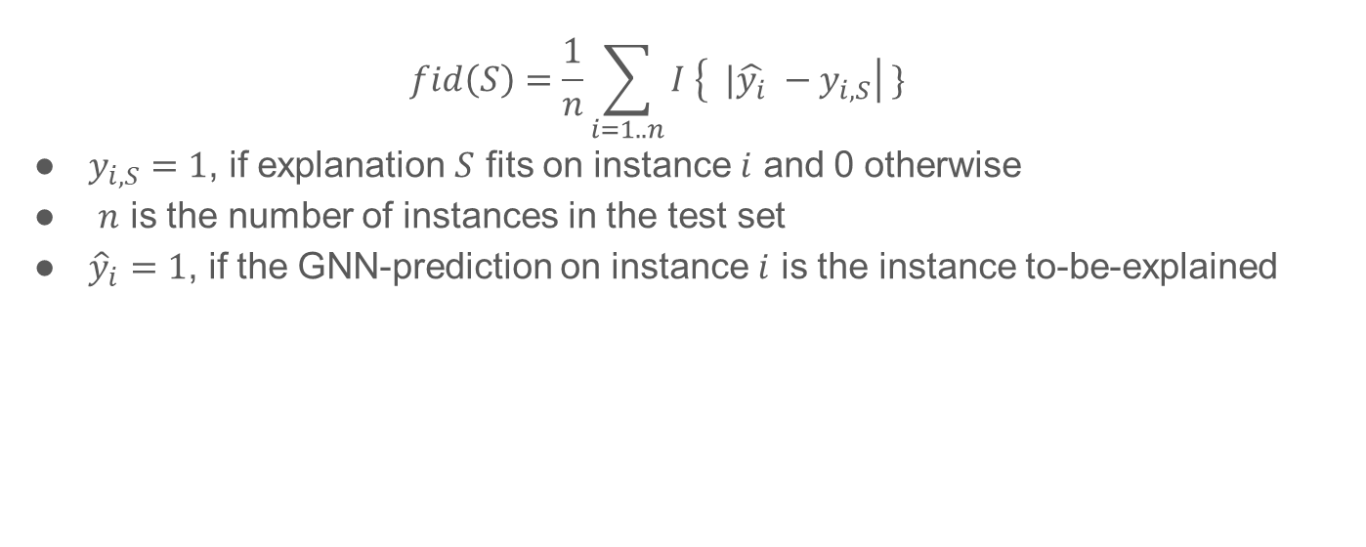
Fidelity redefined
$$fid\left(S\right)=\frac{1}{n}\sum_{i=1..n}{I \left\{ |\hat{y_{i}} −y_{i, S}\right| \} }$$
$y_{i, S}=1$, if explanation $S$ fits on instance $i$ and 0 otherwise
$n$ is the number of instances in the test set
${\hat{y}}_{i}=1$, if the GNN-prediction on instance $i$ is the instance to-be-explained

Slide 38
Properties of individual explanations
Accuracy: If there is only one explanation available, is this correctly found?
Fidelity: How well does an explanation approximate the model?
Consistency: Similarity between explanations for similar models trained on same task
Stability: How similar are explanations for similar instances?
Comprehensibility: How well do humans understand the explanations?
Degree of importance: Is the importance of explanation parts made clear? Can we distinguish the explanation in necessary and sufficient parts?
Novelty: Does the explanation indicate if no similar training data was used?
Following: (Robnik-Sikonja, M. and Marko Bohanec., 2018)

Slide 39
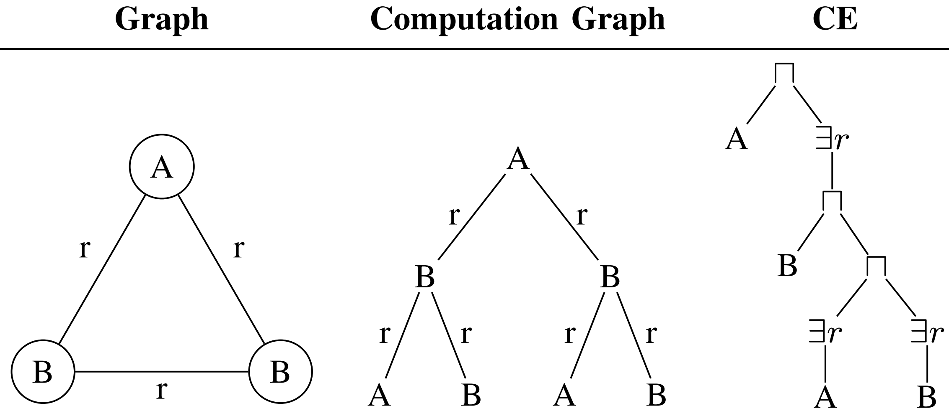
Logical Expressions as Explanations
Computation Tree can also be described by Class Expressions

Slide 40
Logical expressions for MUTAG
Can distinguish between different possible explanations
Graphc from Fig. 5 in https://www.researchgate.net/publication/365081852_INGREX_An_Interactive_Explanation_Framework_for_Graph_Neural_Networks/download

Slide 41
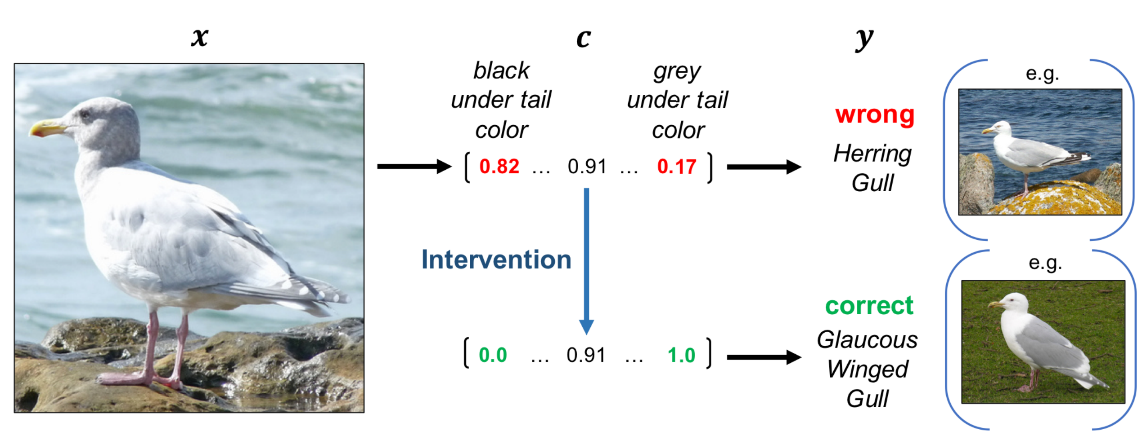
Example of identified concepts
White Box models: Decision Trees on Graphs, Graph Attention Networks
Concept Bottlenecks Models: Human Interceptible
Picture from Figure 3 in (Pang Wei Koh, et al. , 2020)

Slide 42
Conclusion
XAI on graphs is an emerging and important research field
Hard to capture the exact internal workings of a GNN
Different promising ideas, but not yet evaluated, which works best as an explanation

Slide 43
Outlook: Further Research
Identifing important concepts in graphs:
Concept Bottleneck Models
Easier explanations with class expressions
Easier generation of prototypes
Global Explanations
Generating synthetic graphs
Extracting meaningful graphs
Explainers for tasks beyond node and graph classification
Explaining heterogeneous graph data (graphs with different node types)
Using methods from knowledge graphs in XAI on graphs
Finding the optimal way for introducing XAI to end-users

Slide 44
HoT 2: Competition
Who builds the best explanation?

Slide 45
Sources for Definitions of XAI
DARPA: https://www.darpa.mil/program/explainable-artificial-intelligence
Alejandro Barredo Arrieta, et al. "Explainable Artificial Intelligence (XAI): Concepts, taxonomies, opportunities and challenges toward responsible AI". Inf. Fusion 58. (2020): 82–115.
Molnar, Christoph. Interpretable Machine Learning: A Guide for Making Black Box Models Explainable. Deutschland, Leanpub, 2020.
Miller, Tim. "Explanation in artificial intelligence: Insights from the social sciences." Artificial intelligence 267 (2019): 1-38.
Kim, Been, Rajiv Khanna, and Oluwasanmi O. Koyejo. "Examples are not enough, learn to criticize! criticism for interpretability." Advances in neural information processing systems 29 (2016).
Kahneman, Daniel. Thinking, fast and slow. United Kingdom: Penguin random house, 2011.
Vilone, Giulia & Longo, Luca. (2020). Explainable Artificial Intelligence: a Systematic Review. 10.48550/arXiv.2006.00093.

Slide 46
Sources for What is an Explanation?
Miller, Tim. "Explanation in artificial intelligence: Insights from the social sciences." Artificial intelligence 267 (2019): 1-38.
Robert R. Hoffman, et al. "Metrics for Explainable AI: Challenges and Prospects". CoRR abs/1812.04608. (2018).
Langer M., Oster, D., Speith, T., Hermanns, H., K¨astner, L., Schmidt, E., Sesing, A., & Baum, K. (2021). What do we want from Explainabile Artificial Intelligence (XAI)? – A stakeholder perspective on XAI and a conceptual model guiding interdisciplinary XAI research. Artificial Intelligence. doi: 10.1016/j.artint.2021.103473
Robert R. Hoffman, et al. "Measures for explainable AI: Explanation goodness, user satisfaction, mental models, curiosity, trust, and human-AI performance". Frontiers Comput. Sci. 5. (2023).
Popper, Karl. The Logic of Scientific Discovery. Basic Books. (1959).
Forough Poursabzi-Sangdeh, et al. "Manipulating and Measuring Model Interpretability." CHI '21: CHI Conference on Human Factors in Computing Systems, Virtual Event / Yokohama, Japan, May 8-13, 2021. ACM, 2021.

Slide 47
Sources for Taxonomy of Interpretability
Agarwal, Chirag et al. "Evaluating Explainability for Graph Neural Networks". Scientific Data 10. 144(2023).
Schwalbe, Gesina & Finzel, Bettina. (2023). A comprehensive taxonomy for explainable artificial intelligence: a systematic survey of surveys on methods and concepts. Data Mining and Knowledge Discovery. 10.1007/s10618-022-00867-8.
Molnar, C. (2022). Interpretable Machine Learning: A Guide for Making Black Box Models Explainable (2nd ed.). christophm.github.io/interpretable-ml-book/
Yuan, Hao, et al. "On explainability of graph neural networks via subgraph explorations." International conference on machine learning. PMLR, 2021.
Yong-Min Shin, et al. "PAGE: Prototype-Based Model-Level Explanations for Graph Neural Networks". CoRR abs/2210.17159. (2022).
Tien-Cuong Bui, et al. "INGREX: An Interactive Explanation Framework for Graph Neural Networks". CoRR abs/2211.01548. (2022).
Ramprasaath R. Selvaraju, et al. "Grad-CAM: Visual Explanations from Deep Networks via Gradient-Based Localization". Int. J. Comput. Vis. 128. 2(2020): 336–359.
Minh N. Vu, et al. "PGM-Explainer: Probabilistic Graphical Model Explanations for Graph Neural Networks." Advances in Neural Information Processing Systems 33: Annual Conference on Neural Information Processing Systems 2020, NeurIPS 2020, December 6-12, 2020, virtual. 2020.
Hao Yuan, et al. "XGNN: Towards Model-Level Explanations of Graph Neural Networks." KDD '20: The 26th ACM SIGKDD Conference on Knowledge Discovery and Data Mining, Virtual Event, CA, USA, August 23-27, 2020. ACM, 2020.

Slide 48
Sources for Optimizing Explanations
Kakkad, Jaykumar & Jannu, Jaspal & Sharma, Kartik & Aggarwal, Charu & Medya, Sourav. (2023). A Survey on Explainability of Graph Neural Networks.
Zhitao Ying, et al. "GNNExplainer: Generating Explanations for Graph Neural Networks." Advances in Neural Information Processing Systems 32: Annual Conference on Neural Information Processing Systems 2019, NeurIPS 2019, December 8-14, 2019, Vancouver, BC, Canada. 2019.
Hao Yuan, et al. "Explainability in Graph Neural Networks: A Taxonomic Survey". IEEE Trans. Pattern Anal. Mach. Intell. 45. 5(2023): 5782–5799.
Pang Wei Koh, et al. "Concept Bottleneck Models." Proceedings of the 37th International Conference on Machine Learning, ICML 2020, 13-18 July 2020, Virtual Event. PMLR, 2020.
Pietro Barbiero, et al. "Entropy-Based Logic Explanations of Neural Networks." Thirty-Sixth AAAI Conference on Artificial Intelligence, AAAI 2022, Thirty-Fourth Conference on Innovative Applications of Artificial Intelligence, IAAI 2022, The Twelveth Symposium on Educational Advances in Artificial Intelligence, EAAI 2022 Virtual Event, February 22 - March 1, 2022. AAAI Press, 2022.
Yong-Min Shin, et al. "PAGE: Prototype-Based Model-Level Explanations for Graph Neural Networks". CoRR abs/2210.17159. (2022).
Caihua Shan, et al. "Reinforcement Learning Enhanced Explainer for Graph Neural Networks." Advances in Neural Information Processing Systems 34: Annual Conference on Neural Information Processing Systems 2021, NeurIPS 2021, December 6-14, 2021, virtual. 2021.
Dongsheng Luo, et al. "Parameterized Explainer for Graph Neural Network." Advances in Neural Information Processing Systems 33: Annual Conference on Neural Information Processing Systems 2020, NeurIPS 2020, December 6-12, 2020, virtual. 2020.
Xiaoqi Wang, et al. "GNNInterpreter: A Probabilistic Generative Model-Level Explanation for Graph Neural Networks." The Eleventh International Conference on Learning Representations, ICLR 2023, Kigali, Rwanda, May 1-5, 2023. OpenReview.net, 2023.

Slide 49
Sources to Evaluation Methods + Outlook
Finale Doshi-Velez, et al. "Towards A Rigorous Science of Interpretable Machine Learning." (2017).
Robnik-Sikonja, M. and Marko Bohanec. “Perturbation-Based Explanations of Prediction Models.” Human and Machine Learning (2018).
Kenza Amara, et al. "GraphFramEx: Towards Systematic Evaluation of Explainability Methods for Graph Neural Networks." Learning on Graphs Conference, LoG 2022, 9-12 December 2022, Virtual Event. PMLR, 2022.
Dongsheng Luo, et al. "Parameterized Explainer for Graph Neural Network." Advances in Neural Information Processing Systems 33: Annual Conference on Neural Information Processing Systems 2020, NeurIPS 2020, December 6-12, 2020, virtual. 2020.
Agarwal, Chirag et al. "Evaluating Explainability for Graph Neural Networks". Scientific Data 10. 144(2023).
Pang Wei Koh, et al. "Concept Bottleneck Models." Proceedings of the 37th International Conference on Machine Learning, ICML 2020, 13-18 July 2020, Virtual Event. PMLR, 2020.

